Slide 1
Lists #2
A supplemental lesson for AP CSP

Slide 2
Warm-up
What do you remember about lists?
How do you define a list?
How do you access an element in a list?
How do you update an element in a list?
What are some list methods?

Slide 3
Data Abstraction
AP CSP Big Idea #3 - Algorithms and Programming
AAP-1.D.a: Develop data abstraction using lists to store multiple elements.
AAP-1.D.b: Explain how the use of data abstraction manages complexity in program code.
AAP-2.0.a: Write iteration statements to traverse a list.
AAP-2.0.b: Determine the result of an algorithm that includes list traversals.
AAP-3.B: Explain how the use of procedural abstraction manages complexity in a program.

Slide 4
Data Abstraction
Lists allow us to name and work with with large collections of information with few variables. These programs are easier to develop and maintain.
In Python, a list is defined using square brackets.
names = [“Monserat”, “Samantha”, “Diego”, “Omar”, “Diego”]
todo_list = [“read a book”, “wash dishes”, “take shower”]
numbers = [1, 5, 3, 10, 12, 4]
colors_list = [RED, GREEN, BLUE, WHITE, CYAN, PINK, GRAY]

Slide 5
Definitions
A list is an ordered collection of elements (items).
An index is a number used to reference the element in a list and refers to its order in the list.
An element (or item) is an individual value in a list, and each is assigned a unique index.
The length of a list is how many elements it contains. Lists can grow or shrink als elements are added or removed.
0 1 2 3 4
names = [“Monserat”, “Samantha”, “Diego”, “Omar”, “Diego”]
len(names) = 5

Slide 6
Using a List
These list methods are used on the AP Exam:
list.append(element) adds an element to the end of a list.
The length of the list increases by 1.
list.insert(index, element) adds an element at the given index.
The length of the list increases by 1.
The index of all elements following the inserted element are increased by 1.
list.pop(index) removes an element at the given index.
The length of the list decreases by 1.
The index of all elements following the popped element are decreased by 1.

Slide 7
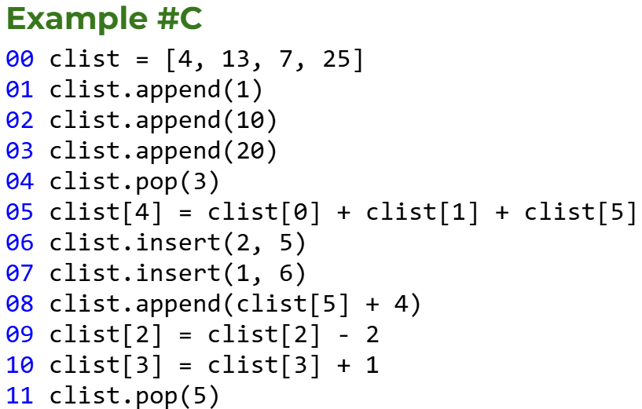
Try some code tracing with lists
Get Example C code from your teacher.
With your group, work through each problem.
What is the final list after the code is executed?

Slide 8
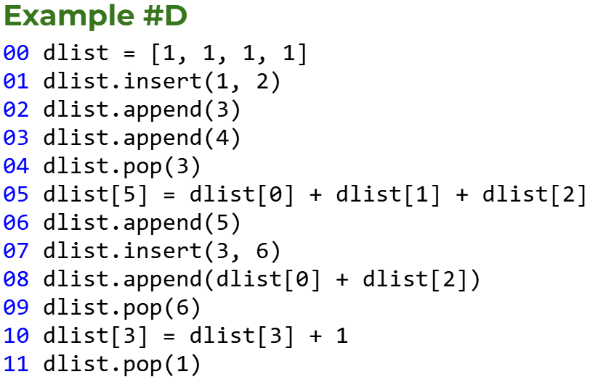
Try some code tracing with lists
Get Example D code from your teacher.
With your group, work through each problem.
What is the final list after the code is executed?

Slide 9
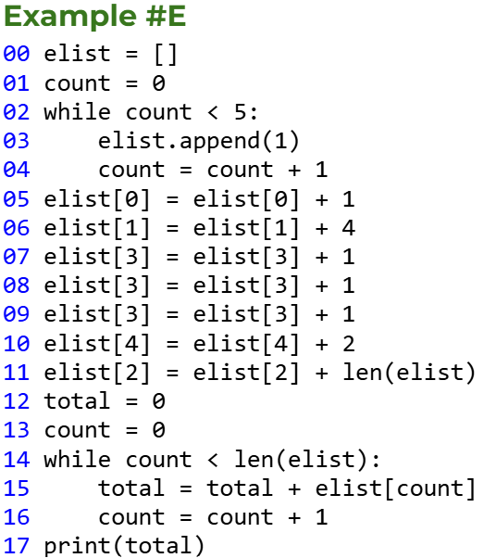
Try some code tracing with lists
Get Example E code from your teacher.
With your group, work through each problem.
What is the value of total after the code is executed?
What is the final list after the code is executed?

Slide 10
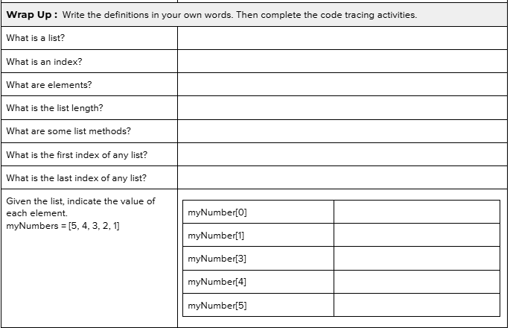
Wrap Up
Complete the activity guide, either individually or as a group.

